Slide 1
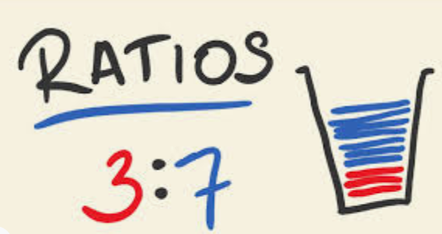
What is Ratio Analysis?

Slide 2

Ratio Analysis
A ratio shows the relationship between
two different numbers.
In accounting and finance, ratios provide information about different business entities or different accounting periods.
Ratios can be used to compare the results of two businesses where one has income in thousands of dollars while the other has income in millions of dollars.

Slide 3

Evaluating Liquidity
A main reason for preparing a balance
sheets is to view the assets, liabilities
and equities at a point in time.
Cash flow statements show cash inflows and outflows.
Both contain information that is important for measuring liquidity.
Cash is liquid. Liquidity ratios show how financially stable a business is, how much cash they have and how quickly they can get cash.

Slide 4

Evaluating Liquidity
Ratios can be used to assess how a business is going.
Measures of Liquidity:
Current ratio (AKA working capital ratio)
Quick asset ratio

Slide 5
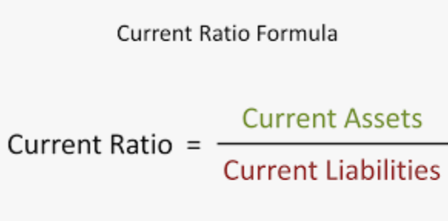
Current ratio
The current ratio is the difference between current assets and current liabilities.
A ratio of 2.0:1.0 (200%) is considered ideal as it shows that:
-for every $1 of current liability,
-the business has $2 of current
assets to meet that obligation.
https://www.double-entry-bookkeeping.com/liquidity-ratios/current-ratio/

Slide 6
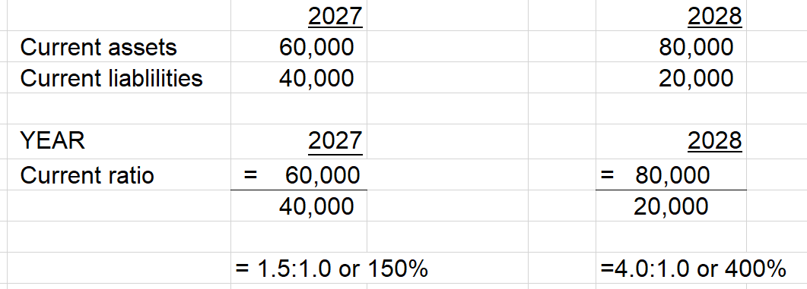
The current ratio for Maired’s Merchandise has been calculated:
In 2027 Maried had $1.50 of current assets for every $1.00 of current liabilities. In 2028 this increased to $4.00 of current assets for every $1.00 of liabilities.
What does this mean?

Slide 7
In 2027 Maried had $1.50 of current assets for every $1.00 of current liabilities. In 2028 this increased to $4.00 of current assets for every $1.00 of liabilities.
What does this mean? This indicates the business should be able to pay all of their short term debts. With a high ratio of 4:1 Maired may need to invest, pay off debts or purchase assets.
Extra: If a ratio is 1:1 or below 1 this indicates a potential problem in paying short –term debts. There is not enough cash or liquidity in the business.

Slide 8
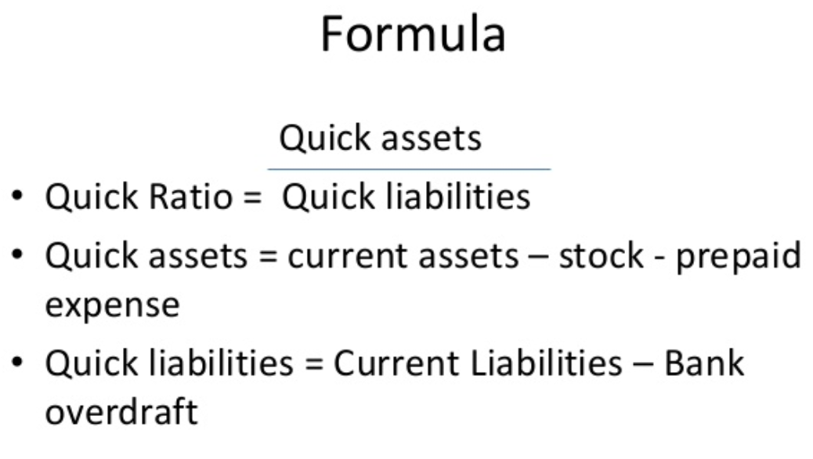
Quick asset ratio
This ratio compares the current assets and ratios that can be quickly converted to cash.
The ideal ratio is 2:1 or 200% as this indicates that
-for every $1 of current liability,
-the business has $2 of current
assets to meet that obligation.

Slide 9
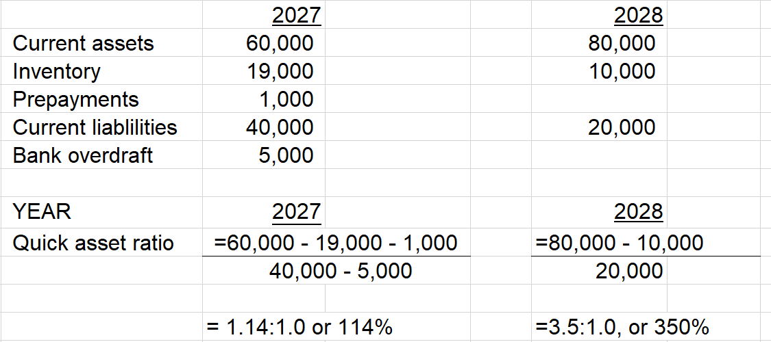
The quick asset ratio for Maired’s Merchandise has been calculated:
In 2027 Maried had $1.14 of quick assets to meet every $1.00 of urgent liabilities. In 2028 this increased to $3.50 of quick assets for every $1.00 of urgent liabilities.
What does this mean?

Slide 10
The quick asset ratio for Maired’s Merchandise has been calculated:
In 2027 Maried had $1.14 of quick assets to meet every $1.00 of urgent liabilities. In 2028 this increased to $3.50 of quick assets for every $1.00 of urgent liabilities.
What does this mean? The liquidity of the firm increased over the 2 years.
https://www.double-entry-bookkeeping.com/liquidity-ratios/quick-ratio/

Slide 11
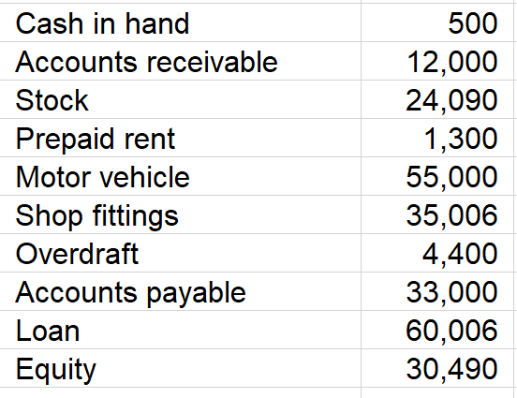
Questions:
Calculate liquidity ratios using the following information, expressing your final result as both a ratio and a percentage. Interpret the results.

Slide 12
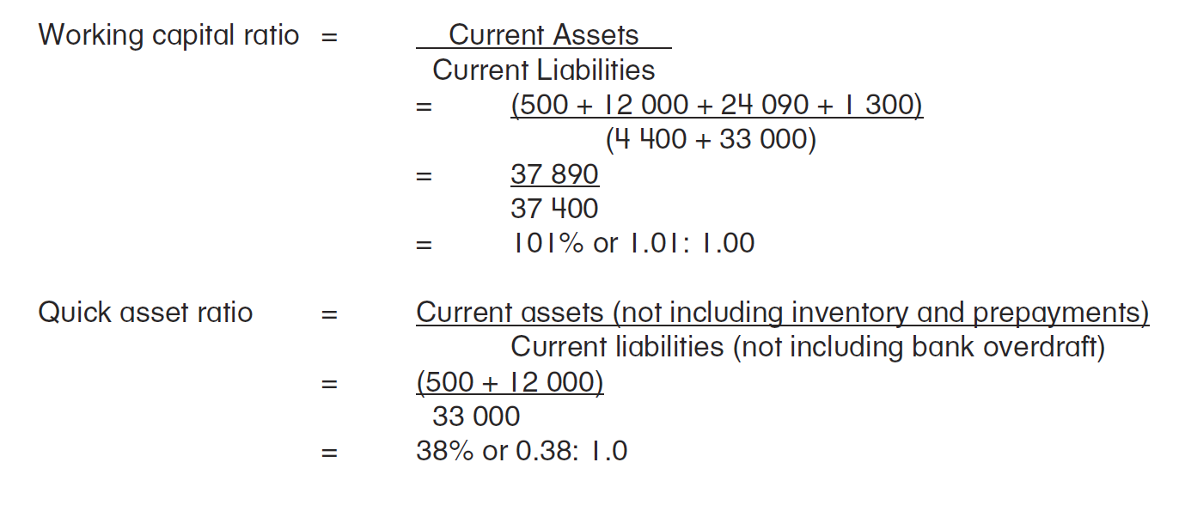
Calculate liquidity ratios using the following information, expressing your final result as both a ratio and a percentage. Interpret the results.

Slide 13
Questions:
Summarise the main liquidity ratios.
What is an ideal current ratio and quick asset ratio?
What does an increase in the liquidity ratios generally indicate?
What does an decrease in the liquidity ratios generally indicate?

Slide 14
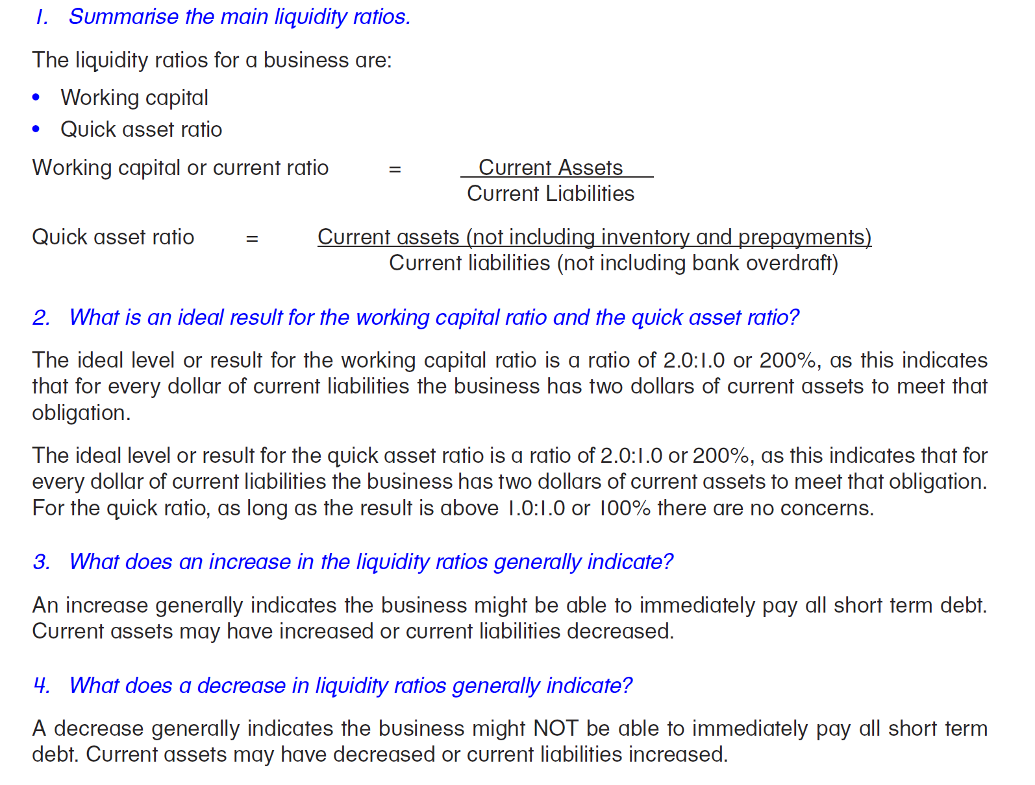

Slide 15

Debt to Equity Ratio
All financing options are provided either internally by owners or
externally by lenders.
Internal financing: Money supplied to the business by the owner,
earned from trading, or from selling assets for cash. All within the
business. Capital is not required to be repaid to the owner.
It is a type of EQUITY.
External financing: Money supplied to the business by a loan provider (eg. bank), who is paid interest, or a trade creditor who supplies products before being paid. All outside the business. A loan must be repaid with interest by a due date.
It is a type of LIABILITY.
The debt to equity ratio aides in comparing external and internal sources of finance. It the relationship between total liabilities (debt) and total equity.

Slide 16
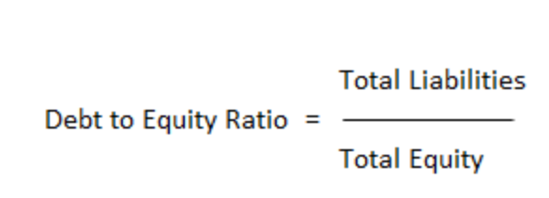
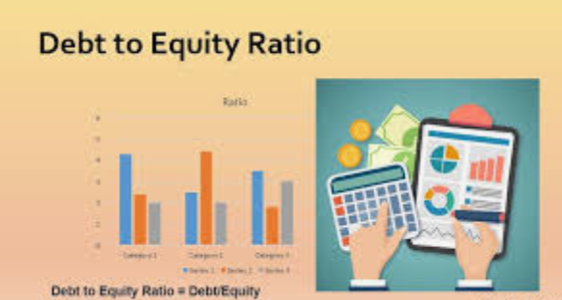
Debt to Equity Ratio
The debt to equity ratio measure the gearing or leverage of a business.
If gearing is high, there is a high level of borrowed external funds compared to internal equity.
If gearing is low, there is a low portion of external debt compared to internal equity.
The formula:
Note: Total liabilities
= Current Liabilities + Non-Current Liabilities

Slide 17
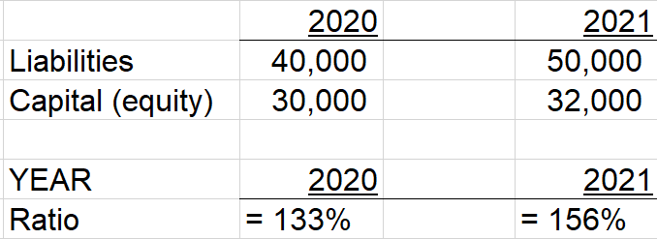
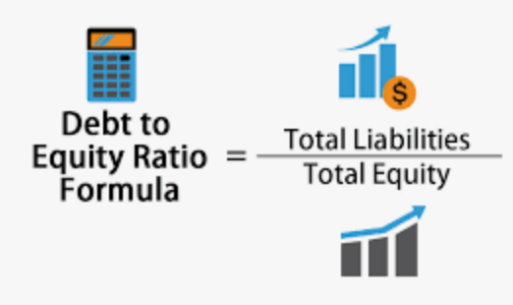
Maired’s Merchandise has reported the following information:
Q. What does this trend indicate?

Slide 18
Maired’s Merchandise has reported the following information:
Q. What does this trend indicate?
This trend indicates an increased reliance on
external sources of funds. There is relatively high level of borrowed funds compared to internally generated owner’s equity.

Slide 19
Calculate the debt to equity ratios for these businesses, and comment on what is indicated about their leverage situation.
Equity $6,000, Liabilities $9,000
Equity $6,000, Liabilities $3,000
Non-current liabilities $123,000, Current liabilities $90,000 and Capital $200,000
Liabilities $900,000, Equity $600,000, Assets $1,500,000
Assets $345,000, Liabilities $125,000

Slide 20
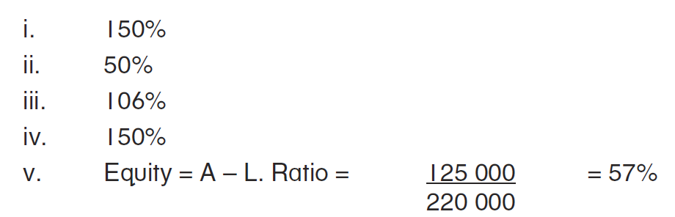
Questions:
Calculate the debt to equity ratios for these businesses, and comment on what is indicated about their leverage situation.
Equity $6,000, Liabilities $9,000
Equity $6,000, Liabilities $3,000
Non-current liabilities $123,000, Current liabilities $90,000 and Capital $200,000
Liabilities $900,000, Equity $600,000, Assets $1,500,000
Assets $345,000, Liabilities $125,000

